Slide 1
Modeling Ordinal Sophistication of Problem-Solving Strategies for Length-Measurement: The Hurdle Approach
Carson Keeter
University of Wyoming – Department of Statistics
Supervised by:
Pavel Chernyavskiy, PhD; University of Virginia – School of Medicine
Traci Shizu Kutaka, PhD; University of Denver – Marsico Institute

Slide 2
Motivation
What metrics should we use to make inferences about student learning?
What is the process we use to generate these metrics?
What evidence do we have that enable us to trust these metrics?
Length-measurement is understudied even though it is a critical bridge between geometry and number concepts (Clements, 2021; Sarama, 2009).

Slide 3

Research Questions
Do children in the Learning Trajectories group use more sophisticated strategies relative to their peers in other learning approaches?
How do we model strategy preference, given a large portion of strategies do not fall onto the existing research-based sophistication scale?
Detectable Strategies vs Non-Codable and Non-Detectable strategies
What can item, student, and classroom random effects tell us about strategy preference?

Slide 4

Sampling Methods and Demographics
Sampling (Randomized Control Trial)
n = 186 kindergarten students
16 classes across 6 schools
149 in 4 public schools, 37 in 2 private schools
104 girls, 82 boys
School District
53.8% Latinx, 24.7% White, 13.2% African American, 3.2% Asian, 0.7% American Indian, 0.4% Native Hawaiian or Other Pacific Islander, and 4.1% respondents who identified as having Two or More Races.
65% of students qualify for free-/reduced-lunch
36.3% are English-Language Learners

Slide 5
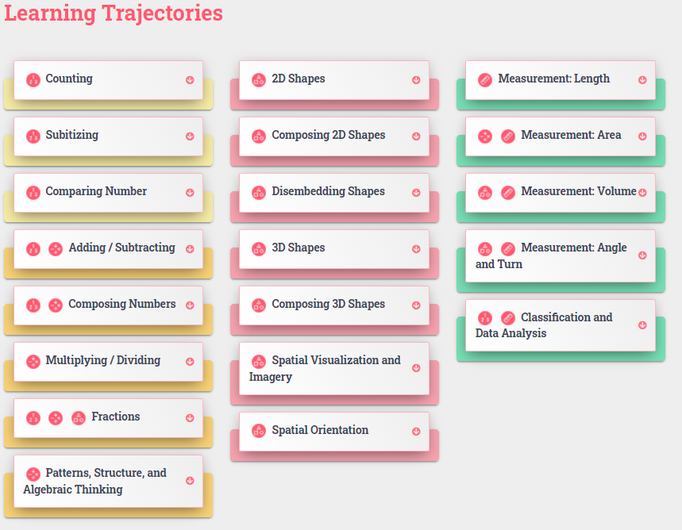
Experimental Conditions
Three Conditions:
Learning Trajectory (LT): 70 students
Reverse-order (REV): 59 students
Business-as-Usual (BAU): 57 students
LT and REV students received one-on-one instruction using the same activities from the length LT, while the REV condition reversed the order of activities presented
BAU did not receive one-on-one instruction
https://www.learningtrajectories.org/math/learning-trajectories

Slide 6
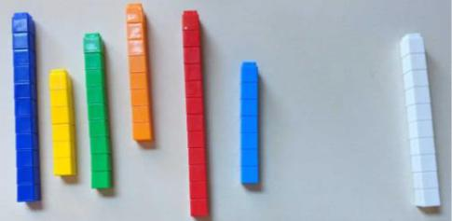
Data Collection and Coding: Pre- and Post-Assessment
Composed of 28 items developed to assess length measurement learning (Research-Based Early Mathematics Assessment, Clements, 2008/2020)
Each item was scored for correctness and sophistication for the strategy observed
Sophistication was made up of up to 10 research-based codes then collapsed into 4-point ordinal scores.

Slide 7
Data Collection and Coding: Pre- and Post-Assessment
Example:
“Can you put these in order from the shortest to longest?” When the child is done, give him/her the tower made of ten white cubes, and say, “I forgot this one! Can you place it so they are all in order?”
Item H from LT Studies: Measurement Unit 6 Length – Fall 2019

Slide 8
Data Collection and Coding: Pre- and Post-Assessment
Research Based Sophistication Codes:
1 = Plays without attempting item
10 = Uses trial and error repeatedly to order
2 = Compares only 2 towers at a time
3 = Separates into categorizes of length without complete ordering within them
4 = Attempts to order without alignment
5 = Attempts to order with alignment
6 = Systematically searches for the next long/shorter tower
7 = Other
8 = Strategy could not be observed
9 = NA

Slide 9
Data Collection and Coding: Pre- and Post-Assessment
4-Point Ordinal Sophistication Coding (collapsed):
L0: 1 = Plays without attempting item
L1: 2 = Compares only 2 towers at a time; 3 = Separates into categorizes of length without complete ordering within them; 4 = Attempts to order without alignment; 10 = Uses trial and error repeatedly to order
L2: 5 = Attempts to order with alignment
L3: 6 = Systematically searches for the next long/shorter tower
H: 7 = Other; 8 = Strategy could not be observed; 9 = NA

Slide 10
Coding process
Most Detectable Strategies were coded 0, 1, 2, or 3 depending on how sophisticated the utilized strategy was
0 = least sophisticated → 3 = most sophisticated
Non-Codable and Non-Detectable Strategies were coded as H (to be processed in the hurdle model)
Cannot be placed on same sophistication scale as Detectable Strategies
L0: 1 = Plays without attempting item
L1: 2 = Compares only 2 towers at a time; 3 = Separates into categorizes of length without complete ordering within them; 4 = Attempts to order without alignment; 10 = Uses trial and error repeatedly to order
L2: 5 = Attempts to order with alignment
L3: 6 = Systematically searches for the next long/shorter tower
H: 7 = Other; 8 = Strategy could not be observed; 9 = NA

Slide 11
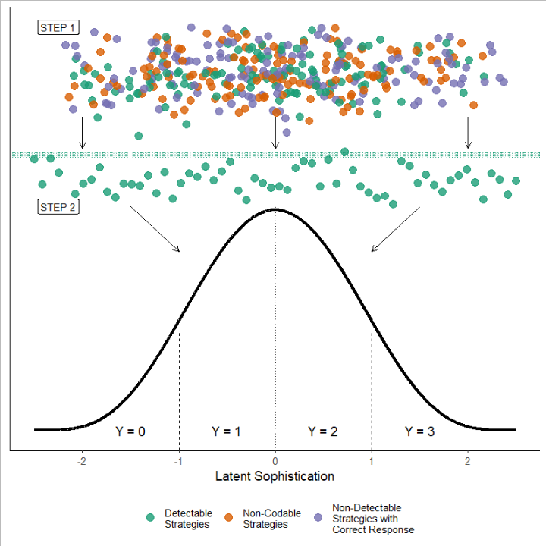
The Hurdle Modeling Approach
Step 1: Collect and Code Data
Detectable Strategies
Non-Codable Strategies
Non-Detectable Strategies with Correct Responses
Step 2 (a): Filter Detectable Strategies
and determine sophistication level
0 = mean level of latent sophistication in the population of kindergarten-aged children.
Step 2 (b): Determine probability of Non-Codable and Non-Detectable Strategies based on what’s left over
T2
T1
T3

Slide 12

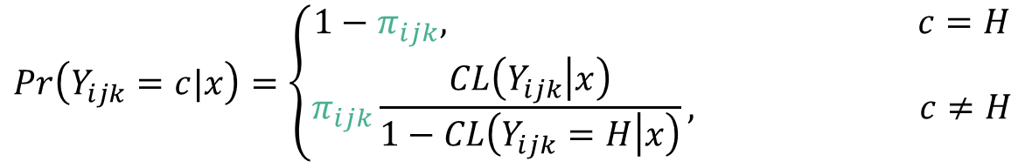
Statistical Analysis: hurdle model
Bayesian Framework in R, Stan
Cumulative Logit Hurdle Model
$Y_{ijk}$ denotes one of 4 detectable strategies (0, 1, 2, 3) used by i-th child, on the j-th item, in k-th classroom
$π_{ijk}$ denotes the probability of recording a detectable strategy
$CL\left(Y_{ijk}≠H | x\right)$denotes the cumulative logit model (McCullagh, 1980) given strategy was detected
$$Pr\left(Y_{ijk}=c|x\right)=\left\{\begin{aligned}1−π_{ijk}, c=H \\ &π_{ijk}\frac{CL\left(Y_{ijk} | x\right)}{1−CL\left(Y_{ijk}=H | x\right)}, c≠H\end{aligned}\right.$$

Slide 13

Statistical Analysis: hurdle model
Cumulative Logit Hurdle Model
$Y_{ijk}$ denotes one of 4 detectable strategies (0, 1, 2, 3) used by ith child, on the jth item, in kth classroom
$π_{ijk}$ denotes the probability of recording a detectable strategy
We assume that non-codable and non-detectable strategies are not observable under the cumulative model:
$$CL\left(Y_{ijk}=H | x\right)=0$$
$$Pr\left(Y_{ijk}=c|x_{ijk}\right)=\left\{\begin{aligned}1−π_{ijk}, c=H \\ &π_{ijk}×\left[Pr\left(Y_{ijk}≤c+1 | x_{ijk}\right)−Pr\left(Y_{ijk}≤c|x_{ijk}\right)\right], c≠H\end{aligned}\right.$$
Cumulative logit model

Slide 14
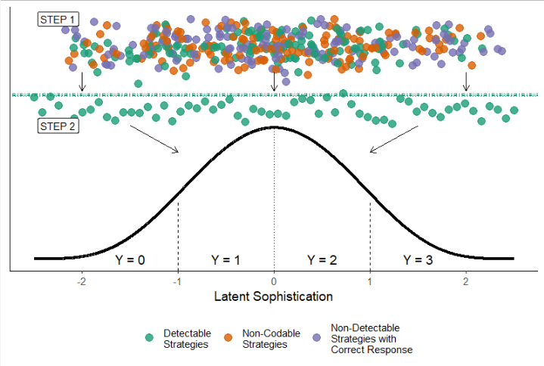

T2
T1
T3
$$Pr\left(Y_{ijk}=c|x_{ijk}\right)=\left\{\begin{aligned}1−π_{ijk}, c=H \\ &π_{ijk}×\left[Pr\left(Y_{ijk}≤c+1 | x_{ijk}\right)−Pr\left(Y_{ijk}≤c|x_{ijk}\right)\right], c≠H\end{aligned}\right.$$
Cumulative logit model

Slide 15
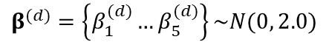
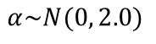
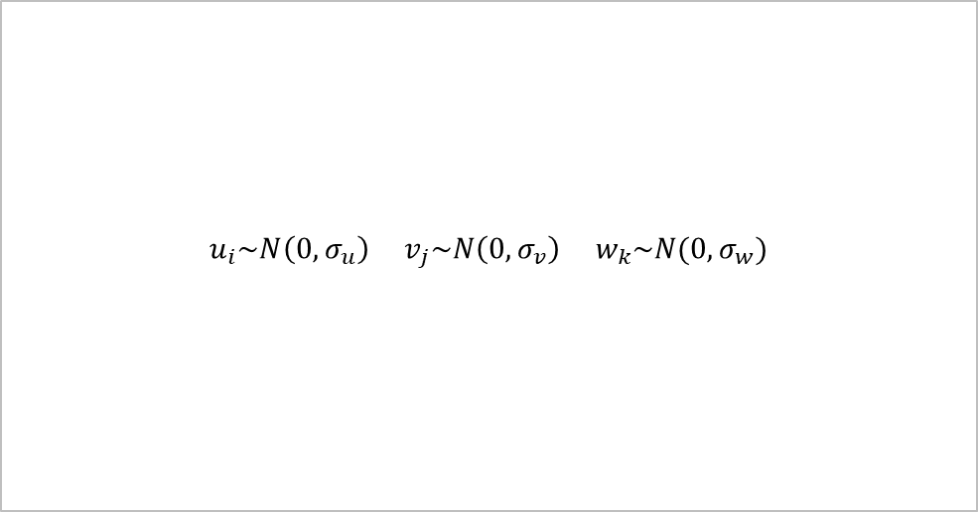
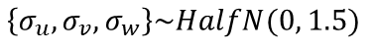
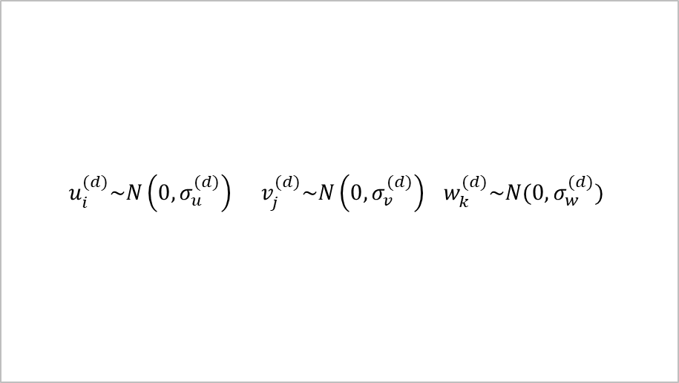
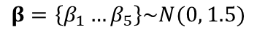
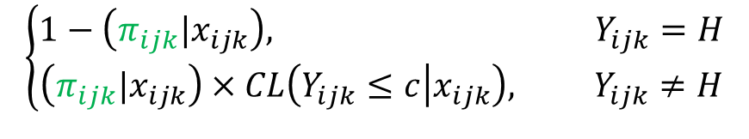
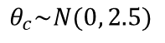
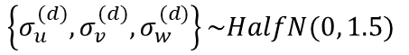
Statistical Analysis: hurdle model
Cumulative Logit Hurdle Model
$$\left\{\begin{aligned}1−\left(π_{ijk}|x_{ijk}\right), Y_{ijk}=H \\ &\left(π_{ijk}|x_{ijk}\right)×CL\left(Y_{ijk}≤c | x_{ijk}\right), Y_{ijk}≠H\end{aligned}\right.$$
$$u_{i}^{(d)}\sim N\left(0,σ_{u}^{(d)}\right) v_{j}^{(d)}\sim N\left(0,σ_{v}^{(d)}\right) w_{k}^{(d)}\sim N(0,σ_{w}^{(d)})$$
$$u_{i}\sim N\left(0,σ_{u}\right) v_{j}\sim N\left(0,σ_{v}\right){ w}_{k}\sim N(0,σ_{w})$$
Probability of Detection
Sophistication Given Strategy Detected
$$logit\left(π_{ijk}\right)=\log\left(\frac{π_{ijk}}{1−π_{ijk}}\right)=α+{x^{′}}_{ijk}β^{(d)}+u_{i}^{(d)}+v_{j}^{(d)}+w_{k}^{(d)}$$
$$logit\left(Pr⁡(Y_{ijk}≤c)\right)=\log\left(\frac{Pr⁡(Y_{ijk}≤c)}{Pr⁡(Y_{ijk}>c)}\right)=θ_{c}−\left({x^{′}}_{ijk}β+u_{i}+v_{j}+w_{k}\right)$$
$$\left\{σ_{u}^{(d)}, σ_{v}^{(d)},σ_{w}^{(d)}\right\}\sim HalfN(0, 1.5)$$
$$\left\{σ_{u}, σ_{v},σ_{w}\right\}\sim HalfN(0, 1.5)$$
$$α\sim N(0, 2.0)$$
$$θ_{c}\sim N(0, 2.5)$$
$$β^{(d)}=\left\{β_{1}^{(d)}…β_{5}^{(d)}\right\}\sim N(0, 2.0)$$
$$β=\left\{β_{1}…β_{5}\right\}\sim N(0, 1.5)$$

Slide 16
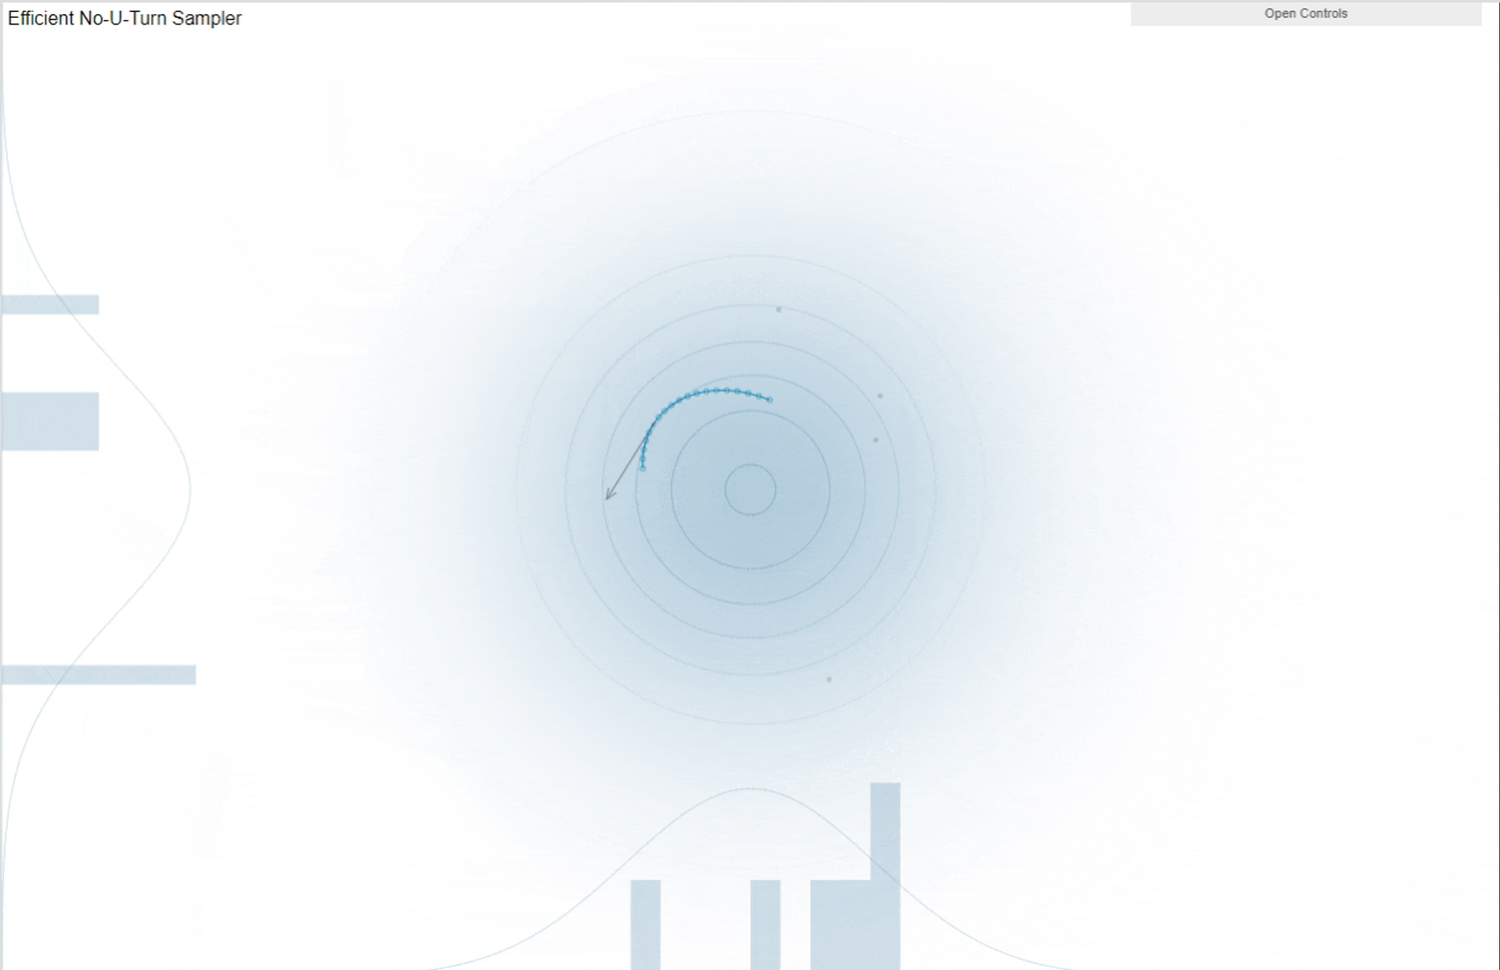
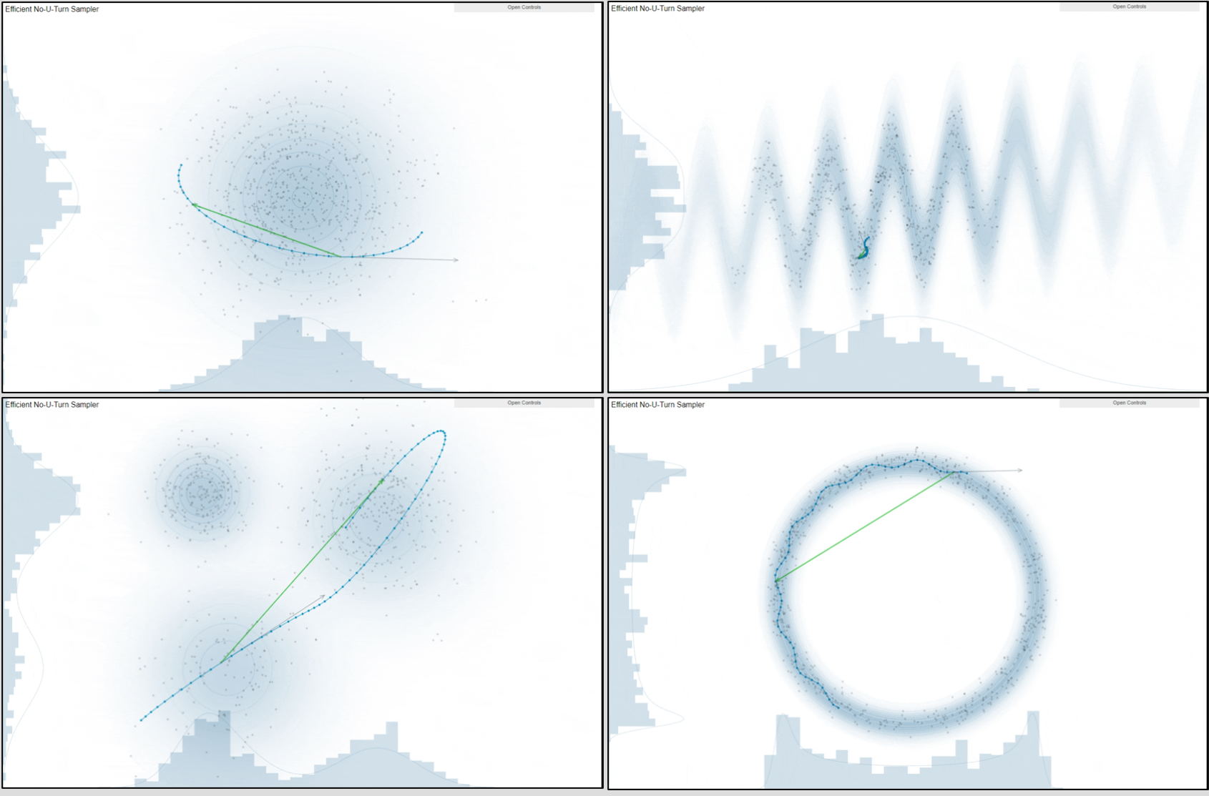
Statistical Analysis: Estimation
Samples were drawn using No U-Turn Sampler (NUTS) [Hamiltonian Monte Carlo Method (HMC)]
Automatically selects an appropriate number of leapfrog steps in each iteration in order to allow the proposals to traverse the posterior
Maximize the expected squared jump distance at each step to avoid random-walk behavior

Slide 17
Statistical Analysis: Estimation
Warmup:
NUTS determines the step size by adapting it during the warm‐up phase to a target acceptance rate (adapt_delta in Stan)
Samples not used in final model
Tuned step size is then used for all sampling iterations
NUTS Process: A Sophisticated Tree Building Algorithm Based on Momentum Vectors
Iteration 1: A single leapfrog step is taken from the current state, so the trajectory has a total of two steps.
Iteration 2+: Two more steps are added (total of four), then four more (total of eight), and so forth, with each iteration doubling the length of the trajectory
This procedure repeats until the trajectory turns back on itself and a U‐turn occurs or the trajectory diverges
Once a terminal point is reached, steps 1-4 repeat until the pre-defined number of iterations is met

Slide 18
Data Summary

Slide 19
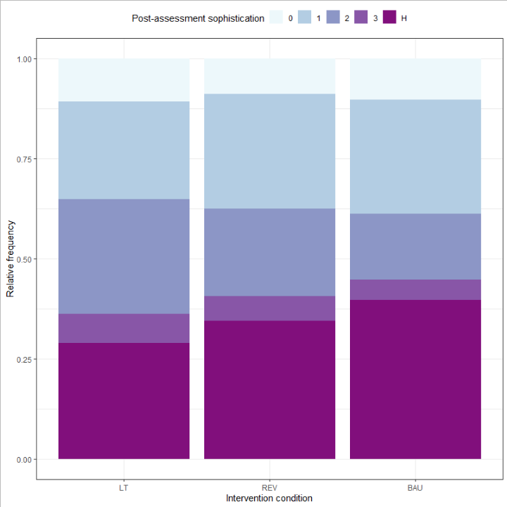
Post-assessment sophistication across Intervention Conditions
8.87%
0 - 3 = lowest to highest post-assessment sophistication strategy
H = non-detectable (non-codable) sophistication strategy
10.8%
10.3%
Without the Hurdle Model?
Losing an average of 34.43% of information within each condition
Takeaways:
LT has the smallest proportion of non-codable & non-detectable strategies
BAU has the largest proportion of non-codable & non-detectable strategies
LT also has a larger proportion of more sophisticated strategies when compared to the other two conditions
24.3%
28.7%
28.5%
16.4%
21.8%
5.01%
28.7%
6.10%
7.21%
29.0%
34.5%
39.8%

Slide 20
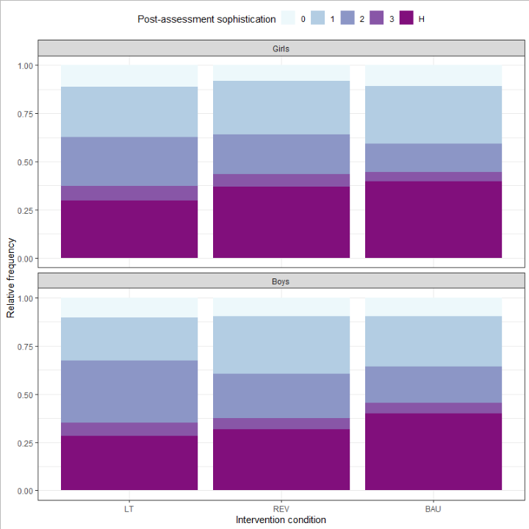
Post-assessment sophistication across Boys & Girls
11.4%
8.09%
10.7%
0 - 3 = lowest to highest post-assessment sophistication strategy
H = non-detectable (non-codable) sophistication strategy
25.8%
27.7%
30.0%
20.7%
14.8%
25.6%
6.45%
4.78%
Without the Hurdle Model?
Losing an average of 35.47% of information within girls within each condition
Losing an average of 33.33% of information within boys within each condition
Takeaways:
Boys & girls within LT have the lowest proportion of non-codable & non-detectable strategies
LT has a larger proportion of more sophisticated strategies for both boys & girls
7.46%
29.7%
37.0%
39.7%
10.2%
9.74%
9.63%
22.6%
26.1%
29.8%
18.9%
32.0%
23.0%
5.37%
6.94%
5.72%
28.3%
31.7%
40.0%

Slide 21
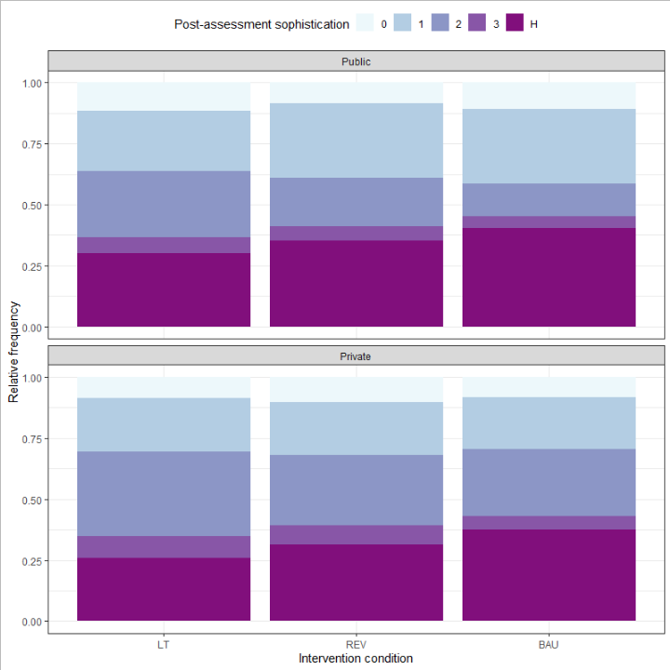
Post-assessment sophistication across School Type
11.4%
8.47%
10.8%
0 - 3 = lowest to highest post-assessment sophistication strategy
H = non-detectable (non-codable) sophistication strategy
25.0%
30.5%
30.4%
20.0%
13.4%
26.9%
4.87%
Without the Hurdle Model?
Losing an average of 35.23% of information within public schools within each condition
Losing an average of 31.4% of information within private schools within each condition
Takeaways:
Same story, different setting: LT has a larger proportion of more sophisticated strategies when compared to the other conditions with public & private schools
6.72%
5.65%
30.0%
35.3%
40.4%
8.66%
10.4%
8.30%
21.8%
21.6%
21.1%
28.8%
27.7%
34.9%
5.54%
8.94%
7.91%
25.7%
31.3%
37.4%

Slide 22
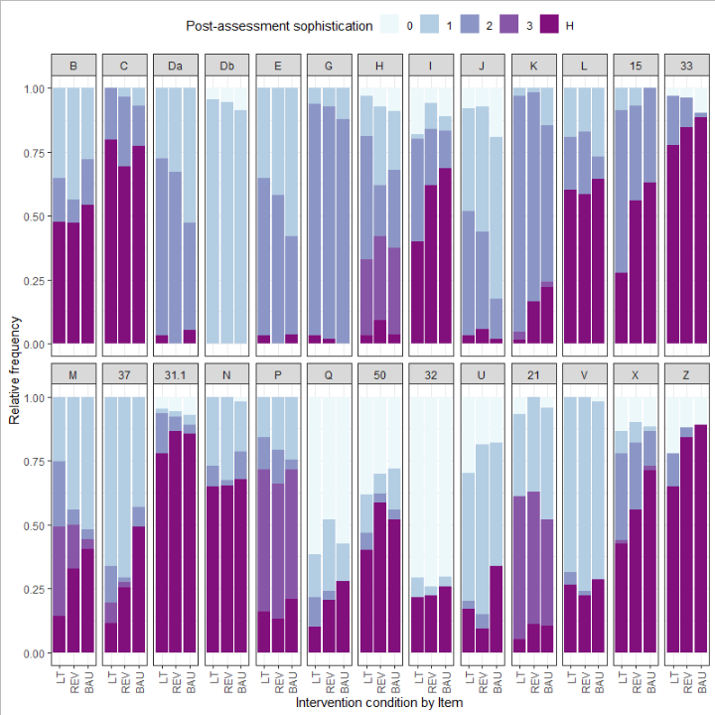
Post-assessment sophistication across Intervention Conditions by Item
0 - 3 = lowest to highest post-assessment sophistication strategy
H = non-detectable (non-codable) sophistication strategy
Without the Hurdle Model?
Massive loss of information within most items
Item 33:
83.63% information loss
Item 31.3:
83.26% information loss
Item Z:
79.3% information loss
Takeaways:
Large variability of sophistication strategies within each item regardless of codability

Slide 23
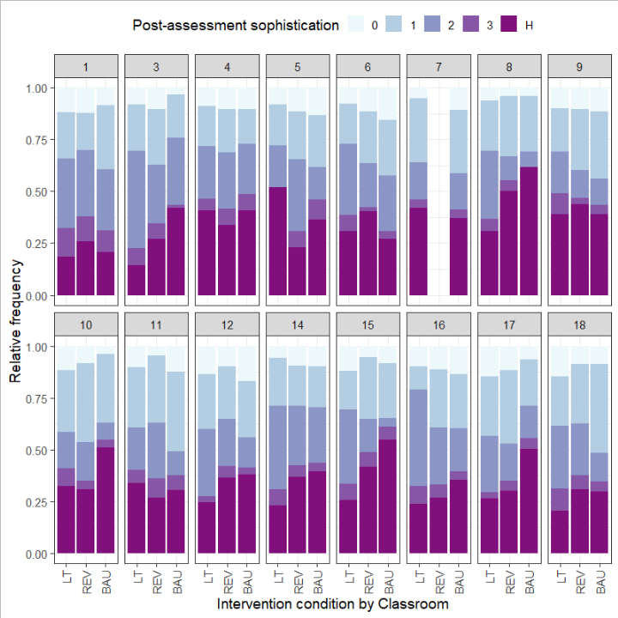
Post-assessment sophistication across Intervention Conditions by Classroom
0 - 3 = lowest to highest post-assessment sophistication strategy
H = non-detectable (non-codable) sophistication strategy
Without the Hurdle Model?
34.32% mean information loss across all classes
Takeaways:
Students in the LT condition within the varying classes follow previous trends when compared to the other strategies:
LT produces more codable strategies
LT produces more sophisticated strategies

Slide 24
Results

Slide 25
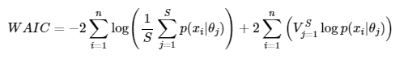
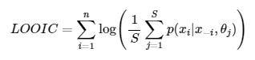
Model Selection
Model* (fixed effects) | WAIC | LOOIC
1) Pre-Soph | 8969.35 | 8970.36
2) Pre-soph + Intervention | 8943.37 | 8944.16
3) Pre-soph x Intervention | 8945.03 | 8945.84
4) Pre-soph + Intervention + Sex | 8943.96 | 8944.74
5) Pre-soph x Intervention + Sex | 8947.53 | 8948.32
6) Pre-soph + Intervention + Sex + Private | 8941.59 | 8942.36
7) Pre-soph x Intervention + Sex + Private | 8943.37 | 8944.18
8) Pre-soph + Intervention + Sex + Private + Private x Intervention | 8944.4 | 8945.23
The lowest _IC indicates the “best” model
Widely Applicable Information Criteria (WAIC): mean log likelihood function over the posterior distribution + correction
Leave-One-Out Information Criteria (LOOIC): mean fit of the model per data point over posterior draws
n = sample size, S = number of draws
*Random Effects: Child ID + Item + Class

Slide 26
Detecting Codable Strategies
-- | Mean | SD | 2.5% | 97.5%
Pre-sophistication | 0.25 | 0.11 | 0.04 | 0.46
LT (w.r.t BAU) | 0.79 | 0.16 | 0.48 | 1.09
REV (w.r.t BAU) | 0.40 | 0.16 | 0.09 | 0.73
Sex (M = 1, F = 0) | 0.12 | 0.14 | -0.15 | 0.39
School Type (Private = 1, Public = 0) | 0.17 | 0.28 | -0.37 | 0.75
Practical Conclusions:
For each SD increase in pre-sophistication Rasch score, the odds of detecting a strategy increase by ~1.3x (exp(0.25))
LT group had ~2.2x (exp(0.79)) greater odds of detecting a strategy when compared to BAU groups
LT children are more likely to use a conceptually meaningful and relevant strategy at post-assessment relative to BAU

Slide 27
Fixed Effects When a Strategy is Detected
-- | Mean | SD | 2.5% | 97.5%
Pre-sophistication | 0.38 | 0.13 | 0.17 | 0.67
LT (w.r.t BAU) | 0.89 | 0.25 | 0.46 | 1.42
REV (w.r.t BAU) | 0.59 | 0.20 | 0.25 | 1.04
Sex (M = 1, F = 0) | 0.04 | 0.13 | -0.21 | 0.30
School Type (Private = 1, Public = 0) | 0.51 | 0.21 | 0.15 | 0.99
Practical Conclusions:
Students in the LT & REV group have significantly higher odds of utilizing more sophisticated strategies than BAU
Boys and girls do not differ significantly in the sophistication of their strategies when a strategy is detected.
Students in private schools have significantly higher odds of utilizing more sophisticated strategies than public schools

Slide 28
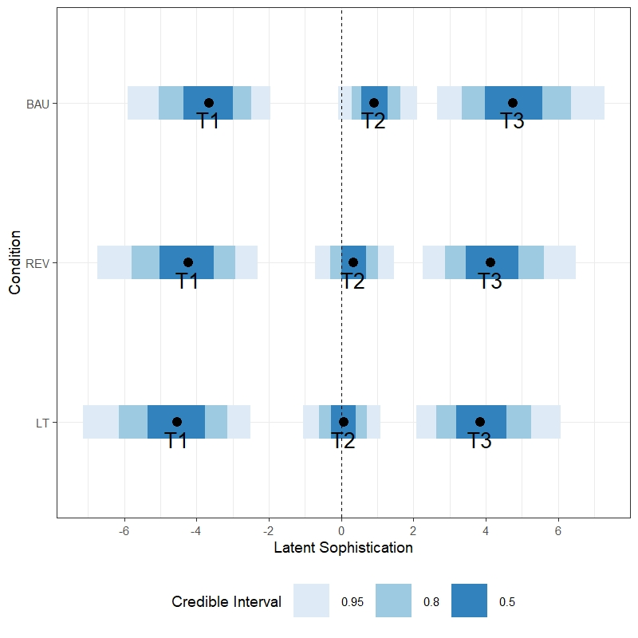
Sophistication Thresholds When a Strategy is Detected
Practical Conclusions:
Average LT students were more likely to deploy a more sophisticated strategy relative to the average BAU or REV students.
For example, the average LT student was making the transition from Y=1 to Y=2 (T2). Whereas, the average student in the BAU condition was likely still in Y=1.
Y=0
Y=1
Y=2
Y=3
Y=0
Y=1
Y=2
Y=3
Y=0
Y=1
Y=2
Y=3
T2
T1
T3

Slide 29
Model* (fixed effects) | P(LT > REV | Detection) | P(Higher Chance of Detectable Strategy in LT)
1) Pre-Soph | -- | --
2) Pre-soph + Intervention | 97.73 | 99.28
3) Pre-soph x Intervention | 97.80 | 99.29
4) Pre-soph + Intervention + Sex | 97.57 | 99.15
5) Pre-soph x Intervention + Sex | 97.87 | 99.32
6) Pre-soph + Intervention +Sex + Private | 97.85 | 99.33
7) Pre-soph x Intervention + Sex + Private | 98.23 | 99.5
8) Pre-soph + Intervention +Sex + Private + Private x Intervention | 96.45 | 98.47
Practical Conclusions:
Given a strategy was detected, there is 97.85% posterior probability that the LT students deploys a more sophisticated strategy relative to REV peers.
There is 99.33% posterior probability that LT students will have a higher chance of using detectable strategies relative to REV peers.
Take Home: Regardless of the model specified, the posterior probability that LT students use more sophisticated strategy relative to their REV peers is above 96%.
*Random Effects: Child ID + Item + Class
Hyper-parameters: chains = 3, warmup = 1000, iter = 5000

Slide 30
Results summary

Slide 31
Results summary
10.8%
8.87%
10.3%
Research Question 1: Given a strategy was detected, do children in the Learning Trajectories group use more sophisticated strategies relative to their peers in two counterfactual conditions?
A: Yes. Given a strategy was detected, there is 97.85% probability that the LT students used a more sophisticated strategy relative to their REV peers.
24.3%
28.7%
28.5%
16.4%
21.8%
5.01%
28.7%
6.10%
7.21%
29.0%
34.5%
39.8%

Slide 32
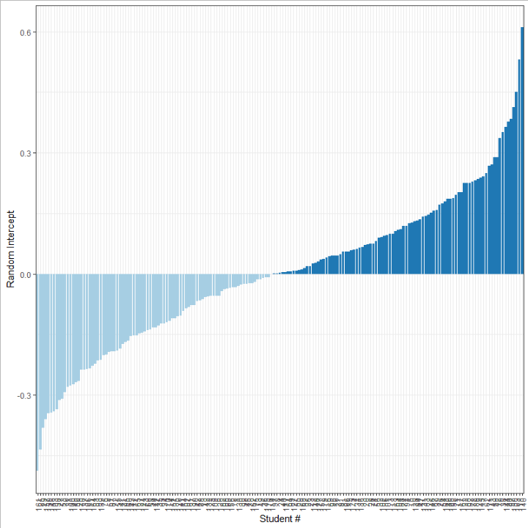
Random Intercepts
Random intercepts measure how different items, classrooms, and students deviate from the population mean latent sophistication
Negative R.I. → Lower sophistication than population mean
Positive R.I. → Higher sophistication than population mean
~ 0 R.I. → ~ Around population mean sophistication
“Typical” population item, classroom, or student
Random effects = 0
Interpretations of fixed effects (e.g., intervention effects) are conditional on all random effects being 0
Typical student from a typical classroom evaluating a typical item

Slide 33
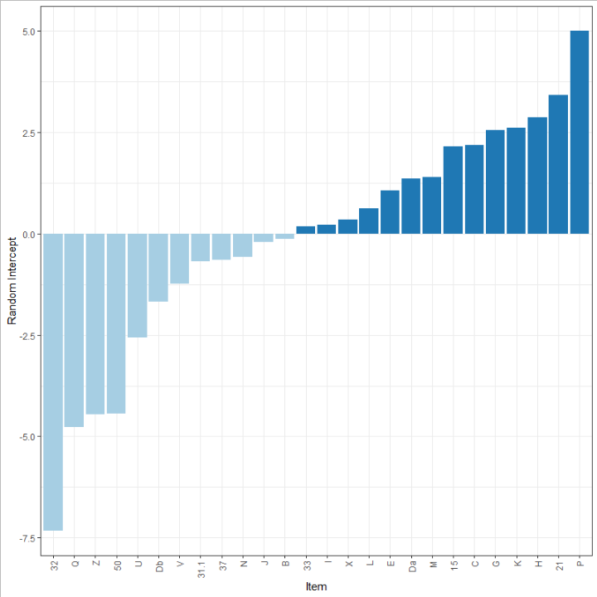
Research Questions
Research Question 2a: What can item random effects tell us about strategy preference?
Item | Random Intercept | Item | Random Intercept
32 | -7.32 | 33 | 0.19
Q | -4.76 | I | 0.23
Z | -4.46 | X | 0.35
50 | -4.43 | L | 0.62
U | -2.56 | E | 1.06
Db | -1.68 | Da | 1.37
V | -1.23 | M | 1.39
31.1 | -0.68 | 15 | 2.15
37 | -0.64 | C | 2.19
N | -0.58 | G | 2.55
J | -0.20 | K | 2.62
B | -0.12 | H | 2.87
- | - | 21 | 3.42
- | - | P | 5.00
Highlighted items are within 0.25 of the mean (0)
“Typical" items in terms of length measurement strategy sophistication

Slide 34
Practical Conclusions:
“Typical” items cover LQR, LDC, EE, & LURR thinking
High sophistication items address EE thinking
Low sophistication items address LURR+ thinking
Notably, there is large deviation between items

Slide 35
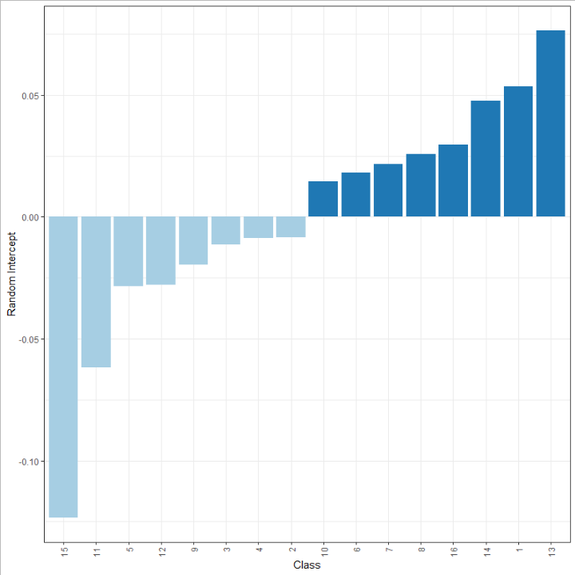
Research Questions
Research Question 2b: What can classroom random effects tell us about strategy preference?
Class | Random Intercept | Class | Random Intercept
15 | -0.12 | 10 | 0.01
11 | -0.06 | 6 | 0.02
5 | -0.03 | 7 | 0.02
12 | -0.03 | 8 | 0.03
9 | -0.02 | 16 | 0.03
3 | -0.01 | 14 | 0.05
4 | -0.01 | 1 | 0.05
2 | -0.01 | 13 | 0.08
Practical Conclusions:
There is very little deviation in latent sophistication between classes
Classrooms likely don't play a major roll in latent sophistication

Slide 36
Research Questions
Research Question 2b: What can student random effects tell us about strategy preference?

Slide 37
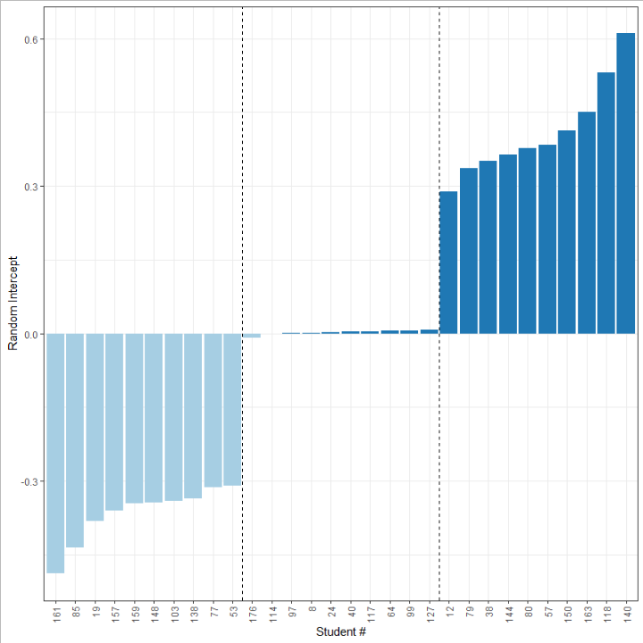
Research Questions
Research Question 2c: What can student random effects tell us about strategy preference?
Below Population Mean Latent Sophistication
Around Population Mean Latent Sophistication
Above Population Mean Latent Sophistication
Below Population Mean Latent Sophistication
Around Population Mean Latent Sophistication
Above Population Mean Latent Sophistication
Student # | R.I. | Student # | R.I. | Student # | R.I.
161 | -0.49 | 176 | -0.01 | 12 | 0.29
85 | -0.44 | 114 | 0.00 | 79 | 0.34
19 | -0.38 | 97 | 0.00 | 38 | 0.35
157 | -0.36 | 8 | 0.00 | 144 | 0.36
159 | -0.34 | 24 | 0.00 | 80 | 0.38
148 | -0.34 | 40 | 0.00 | 57 | 0.38
103 | -0.34 | 117 | 0.00 | 150 | 0.41
138 | -0.34 | 64 | 0.01 | 163 | 0.45
77 | -0.31 | 99 | 0.01 | 118 | 0.53
53 | -0.31 | 127 | 0.01 | 140 | 0.61
Bottom 10 Students
Middle 10 Students
“Typical Students”
Top 10 Students

Slide 38
Research Questions
Research Question 2c: What can student random effects tell us about strategy preference?
Below Population Mean Latent Sophistication
Around Population Mean Latent Sophistication
Above Population Mean Latent Sophistication
Practical Conclusions:
It is possible to score every student in terms of their sophistication and use these scores like Rasch scores in correctness-based assessments.

Slide 39
Research Questions
Research Question 3: How do we best model strategy preference, given a large portion of strategies do not fall onto the existing research-based sophistication scale?
A1: When a strategy can be detected, Pre-sophistication level, Experimental Condition (LT, REV, BAU), & School Type (Public, Private) contribute the most to sophistication.
A2: Regardless of the model specified, the posterior probability that children in the LT condition use more sophisticated strategy vs. REV condition is above 96%.
A3: There is a methodological advantage to using the hurdle model due to the differential probabilities of a detectable strategy by Experimental Condition, Pre-Sophistication, and School Type (less information loss, more power)

Slide 40
Questions?

